Slide 1



BANSAL INSTITUTE OF SCIENCE AND TECHNOLOGY BHOPAL (M.P)
DEPARTMENT OF COMPUTER SCIENCE AND ENGINEERING

Slide 2
Instant Deal
We will deal with all the hassle

Slide 3
GUIDE BY:
Prof. Manish Saxena (HOD | Professor, Dept. of CSE, B.I.S.T., Bhopal)
Prof. Anshu Tiwari (Professor, Dept. of CSE, B.I.S.T., Bhopal)
GROUP MEMBERS:
1. Rahul Gupta 2. Satendra Kumar Saket 3. Rahi Turkar 4. Gagan Bisen 5. Ankit Kumar Chaubey
HOD
Prof. Manish Saxena (HOD | Professor, Dept. of CSE, B.I.S.T., Bhopal)

Slide 4
Presentation Flow
01
Abstract
02
Introduction
03
Implementation
04
Simulation
05
Future Scope

Slide 5
Abstract
A safe place to buy and sell your goods

Slide 6
Introduction
Just drop your item and receive your payment.
Receive your item at your door step.
We will deal with all the hassle for you both.

Slide 7
Implementation Methodologies
HTML | CSS
Bootstrap
SqlLite
Python | Django
Heroku
To built the skeleton of the Website.
For the front-end development.
For the Database.
For the back-end implementation.
For the deployment of the web application.

Slide 8
Problem Statement
Safety
Trust
Quality of product
Billing
Instant deal

Slide 9
Services
Safety
Trust
Proper Bill
20+ Quality check
No waiting
Contact us any time
Repairing
Warehousing

Slide 10
Features
Upload Product
Negotiate
Olx Support

Slide 11
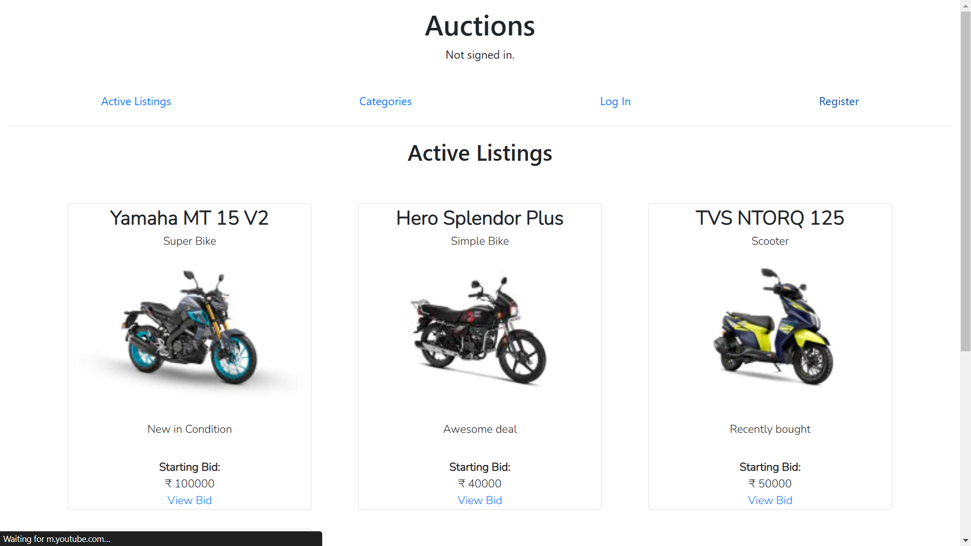

Slide 12
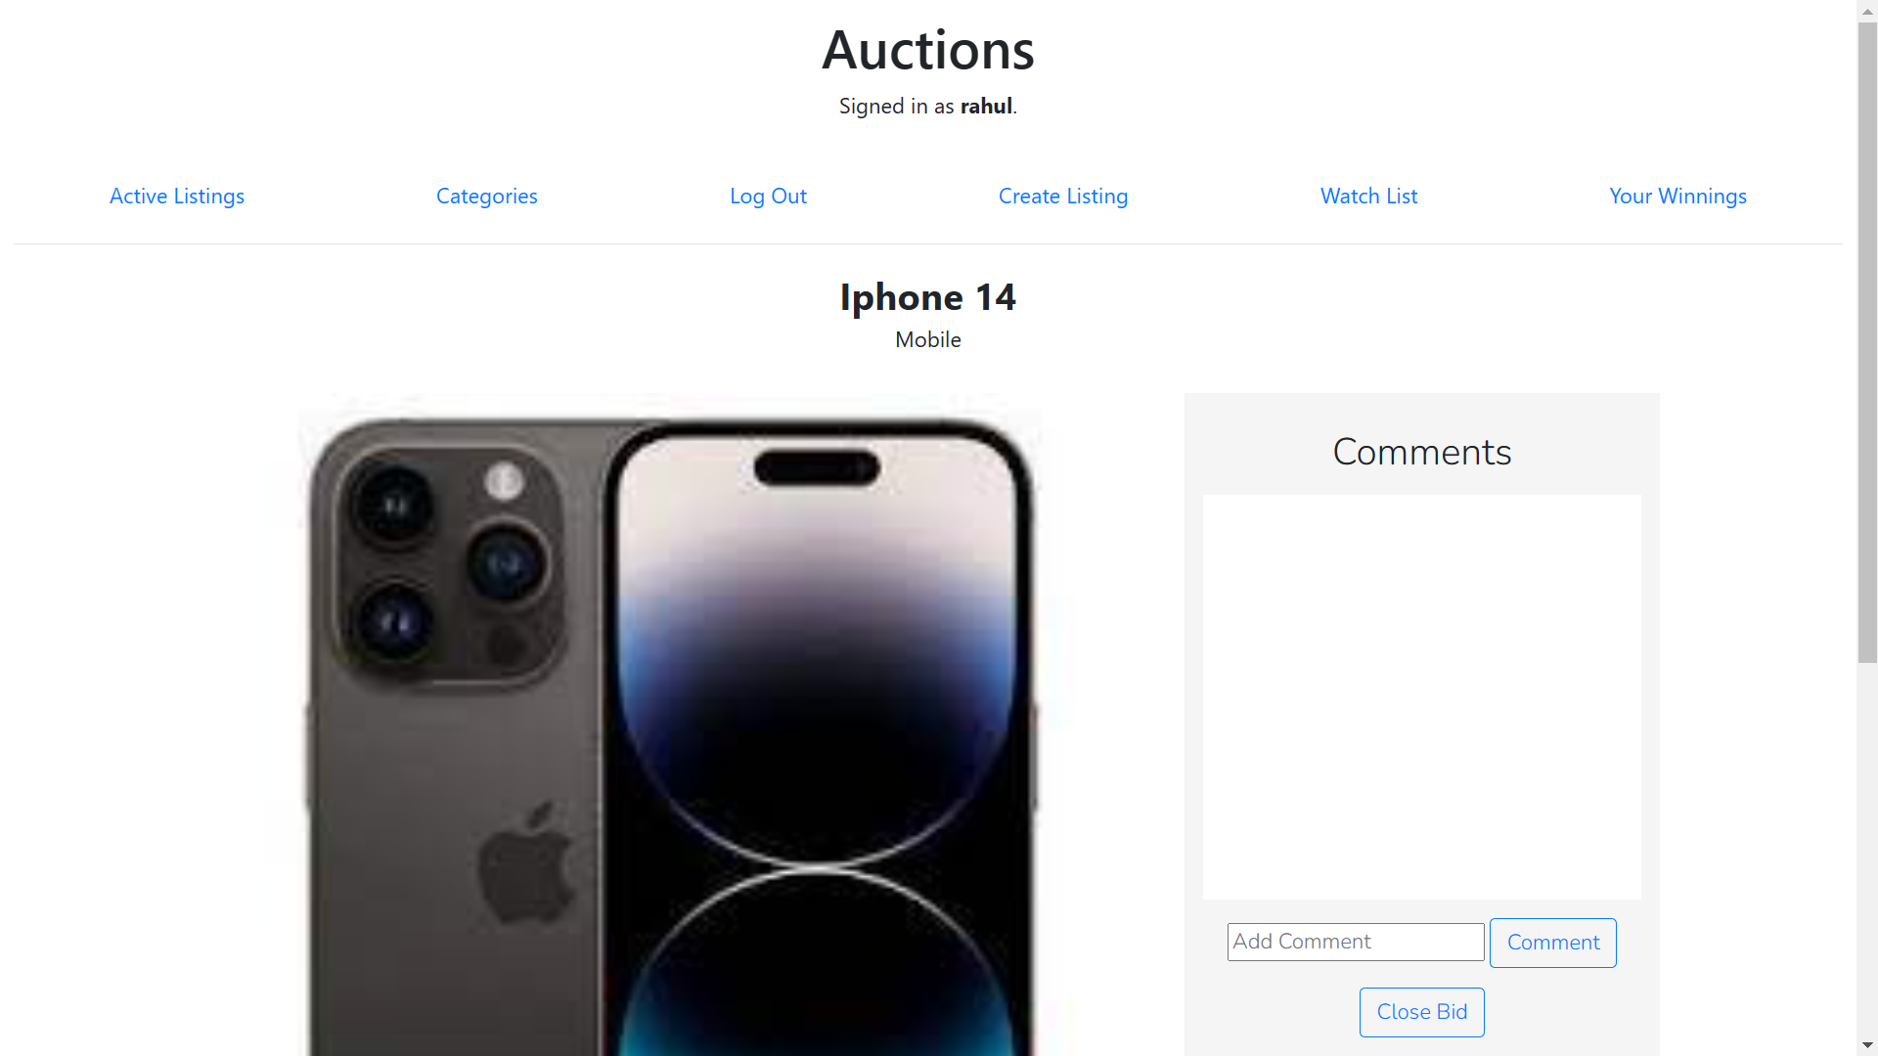
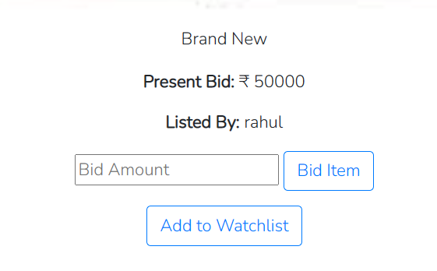

Slide 13
Conclusion
A safe place to buy and sell second hand product.
Instant deal with quality inspection.
Complete billing and document varification.

Slide 14
Future and Scope
Proper other classified web app – API integration.
Payment Integration.
Invoice on mail integration.

Slide 15
THANK YOU

